Slide 1
E500 ELECTRODE
Maintenance Assembly
Reference
IMPLANTER-Diffusion Department
Prepare By: SAMUEL 山姆爾 SaSPAREDOC.02

Slide 2
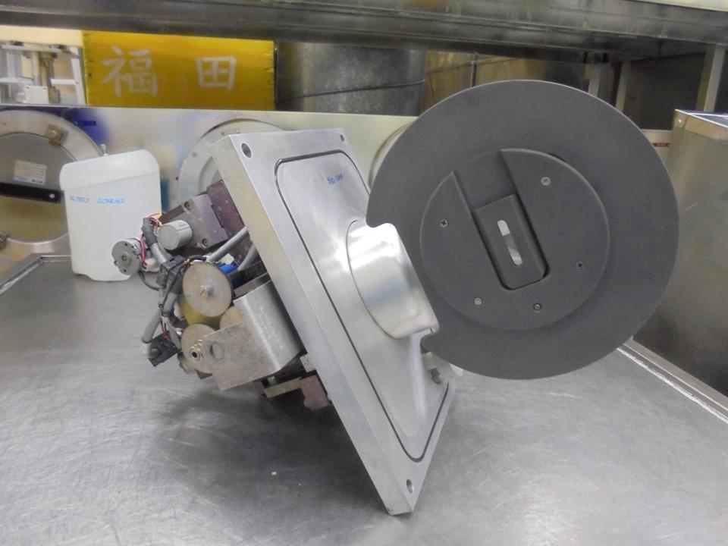
E500 ASSY . ELECTRODE

Slide 3
COMPONENTS

Slide 4
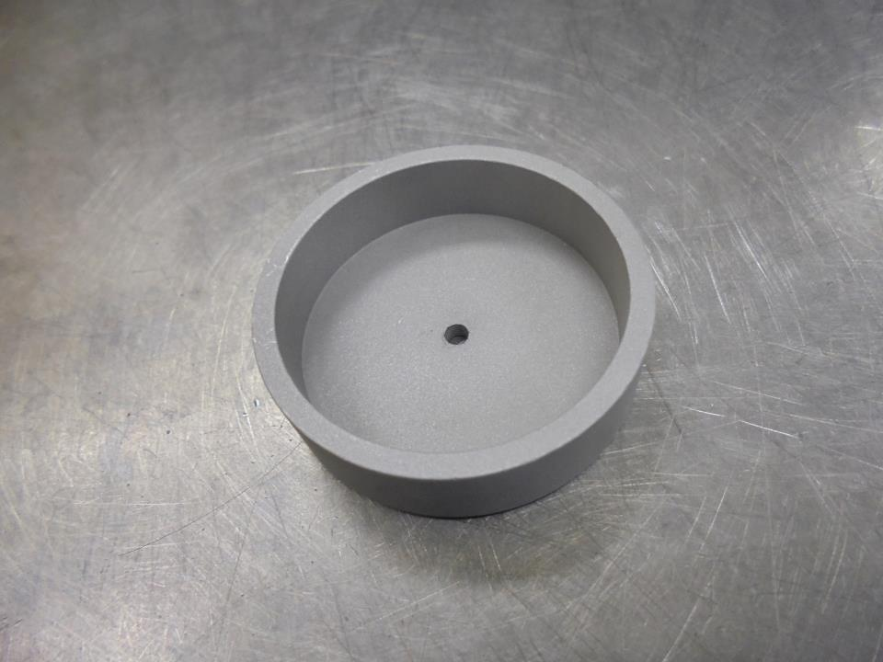
HV FEEDTHRU SHIELDING CAP

Slide 5
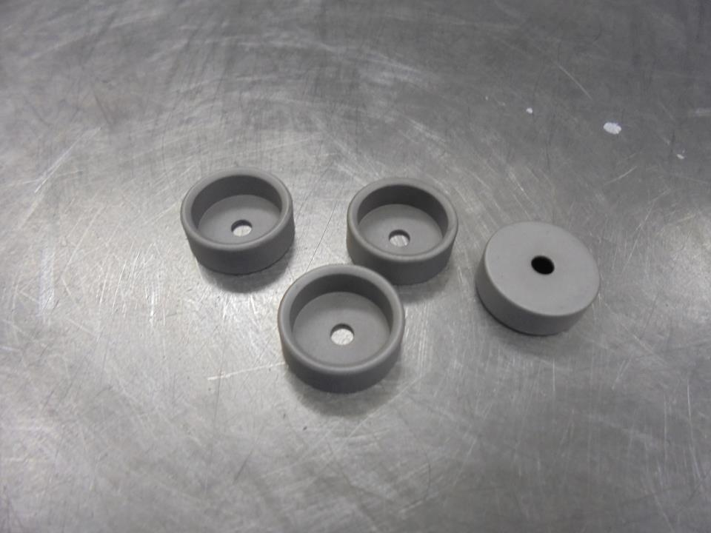
INNER SHIELDING CAP

Slide 6
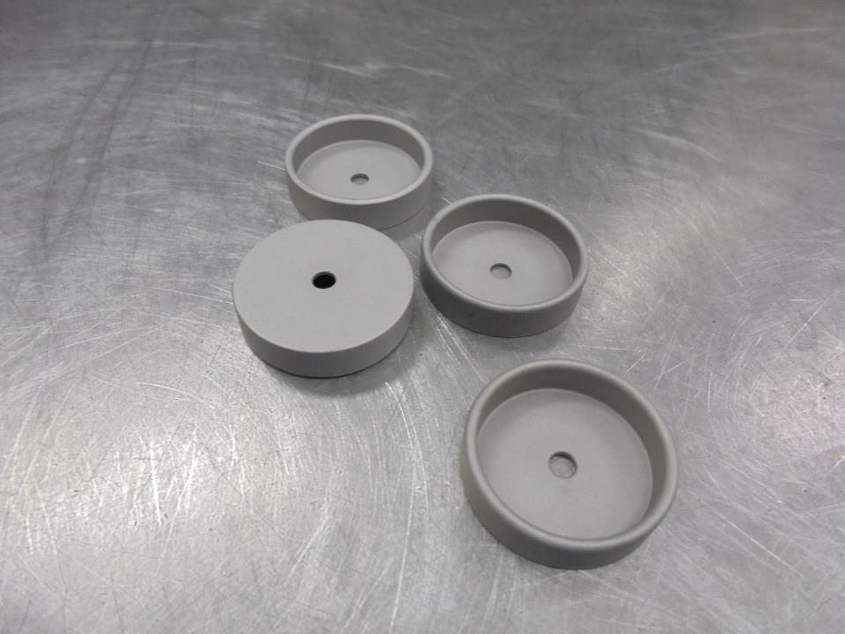
OUTER SHIELDING CAP

Slide 7
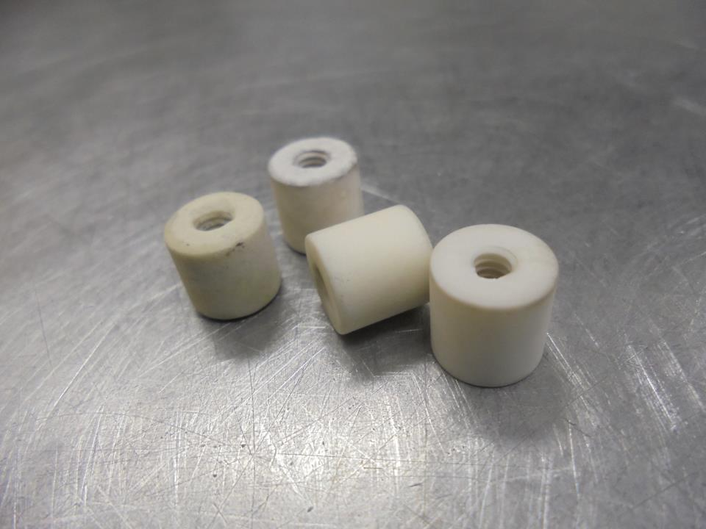
CERAMIC STAND-OFF

Slide 8
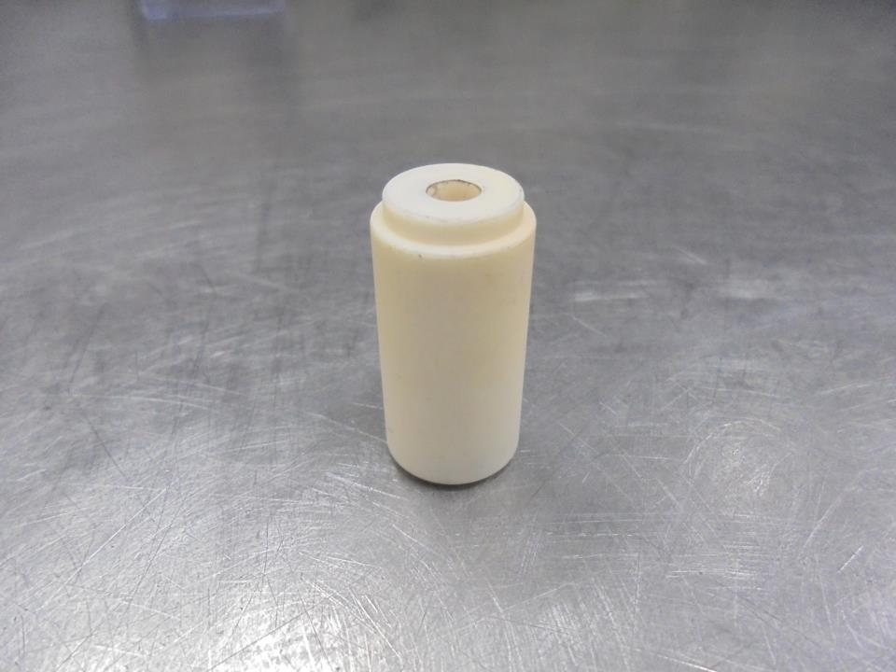
HV FEEDTHRU SHIELDING INSULATOR

Slide 9
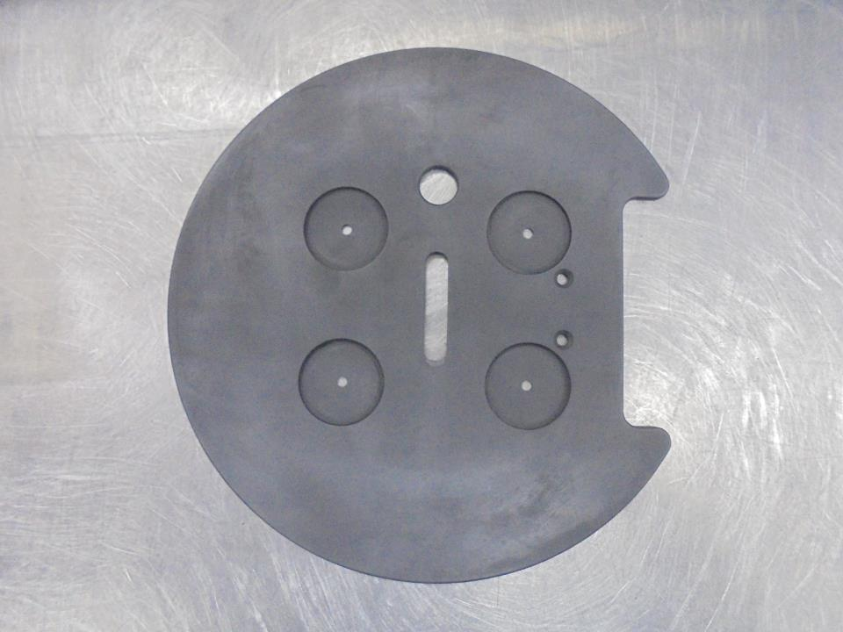
GROUND ELECTRODE [GRAPHITE]

Slide 10
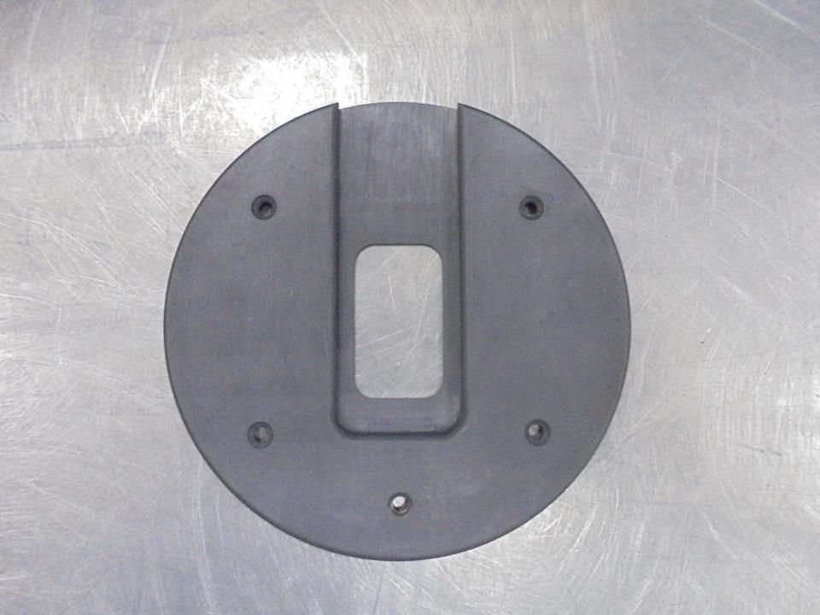
MANIPULATOR MOUNTING PLATE [GRAPHITE]

Slide 11
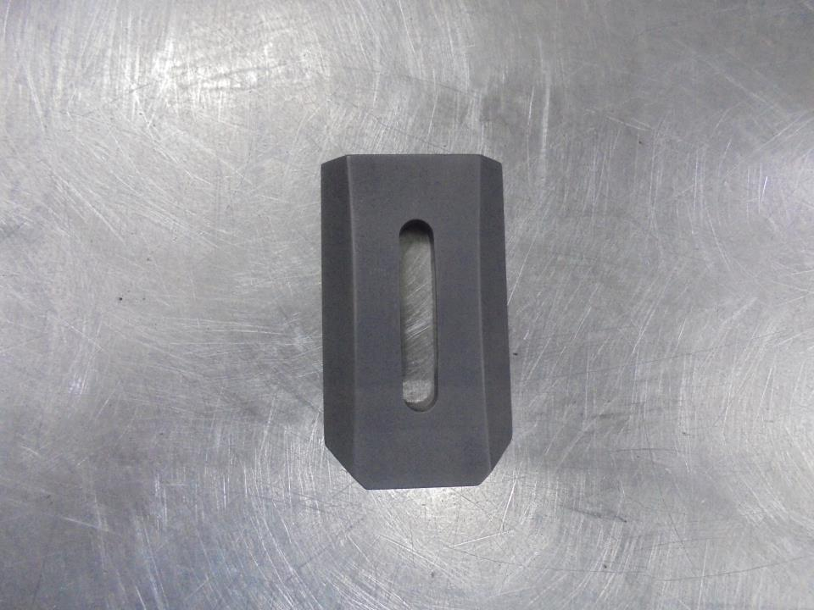
SUPPRESSION ELECTRODE INSERT [GRAPHITE]

Slide 12
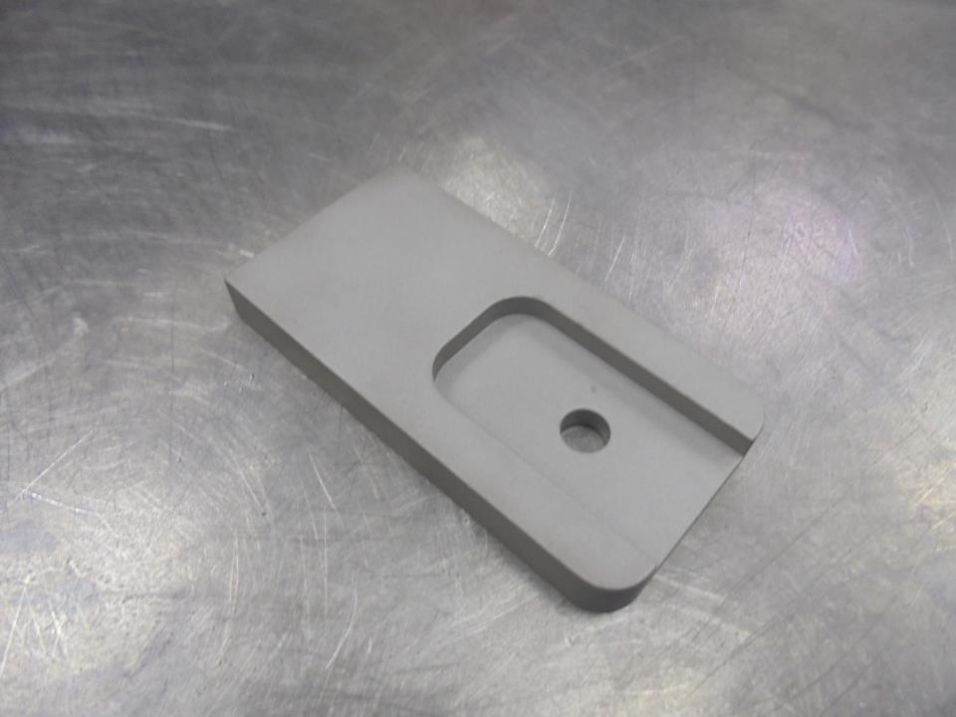
GROUND ELECTRODE HOLDER

Slide 13
ASSEMBLY

Slide 14
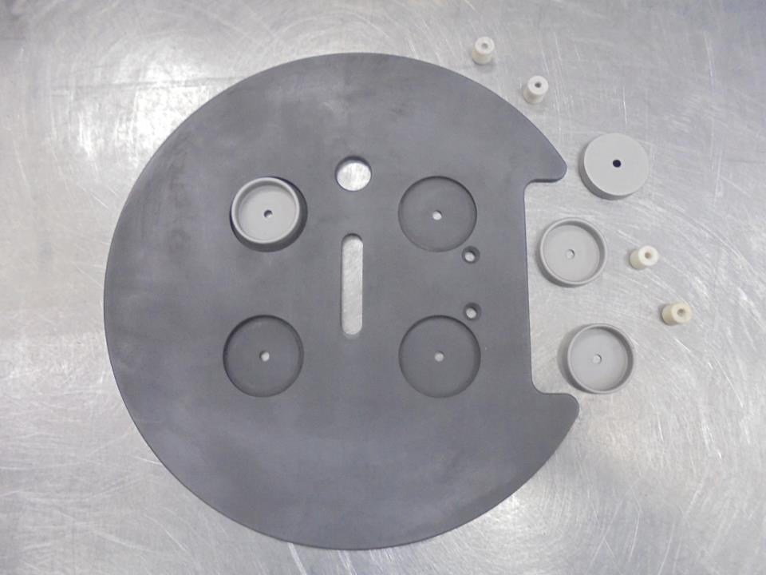
Assemble The Following In ELECTRODE GROUND PLATE:
OUTER SHIELDING CAP
CEREMIC STAND-OFF

Slide 15
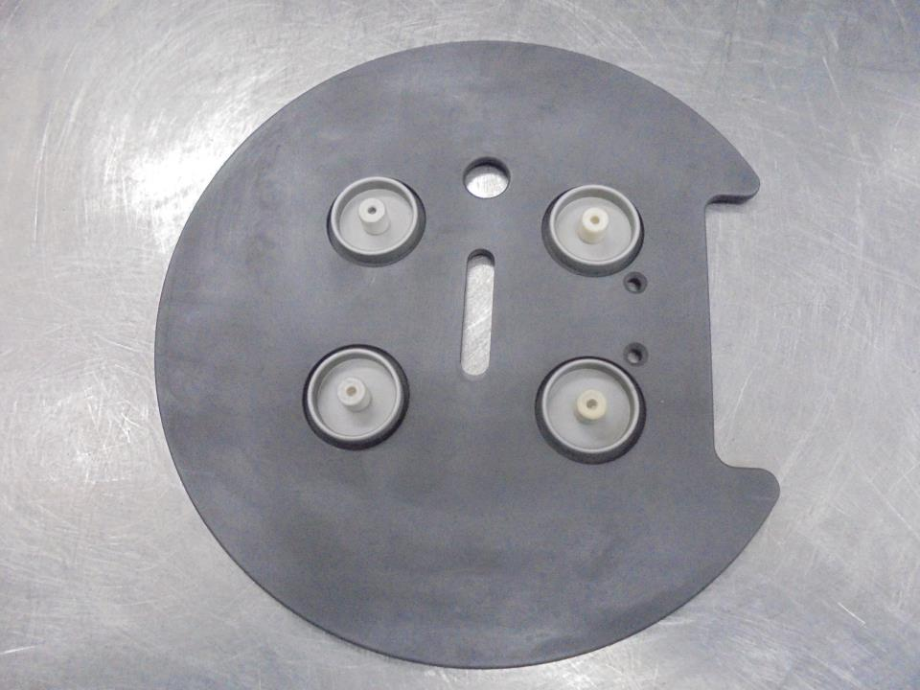
SECURE WITH
4 SCREWS
(in the back)

Slide 16
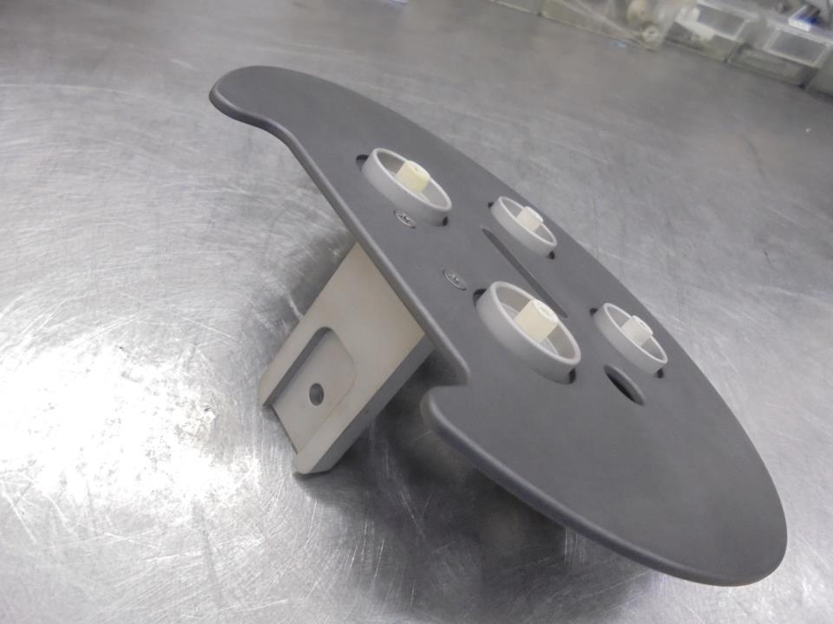
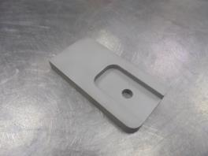
Install the HOLDER

Slide 17
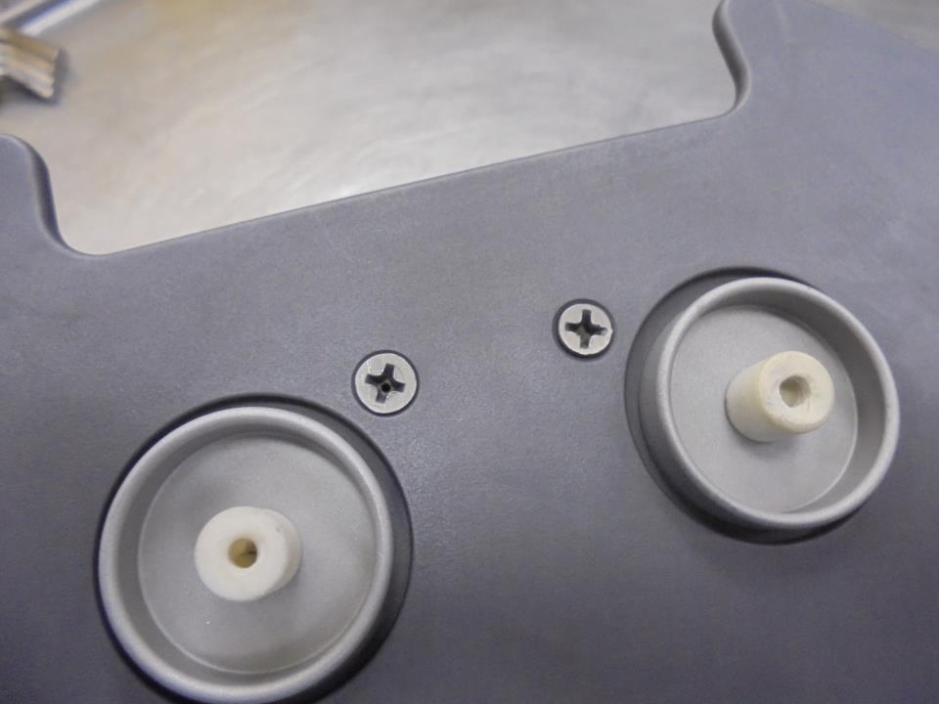
Secure Screws

Slide 18
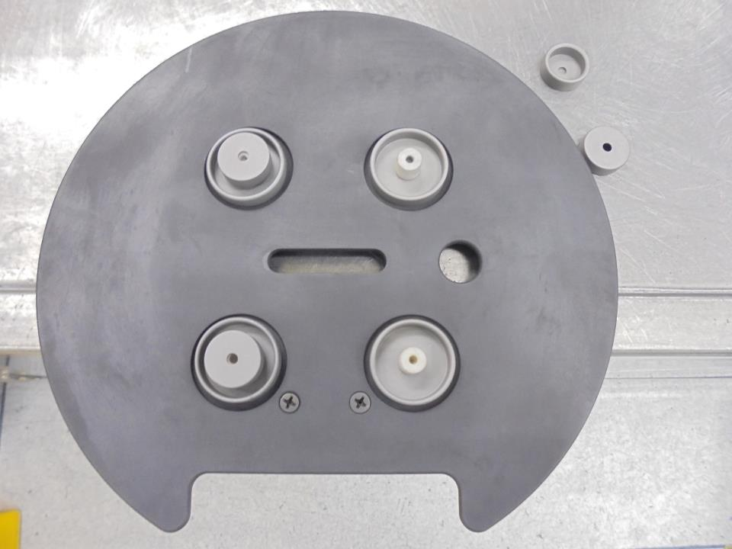
Install The Inner Shielding Cap

Slide 19
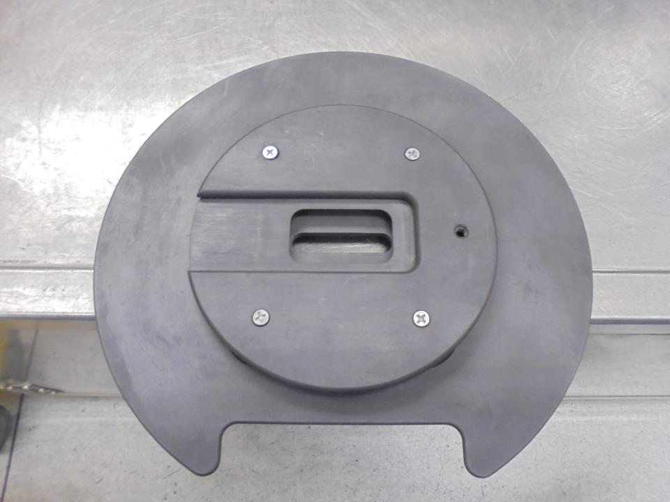
Re-Install Manipulator
Mounting Plate…
Secure With 4 Screws

Slide 20
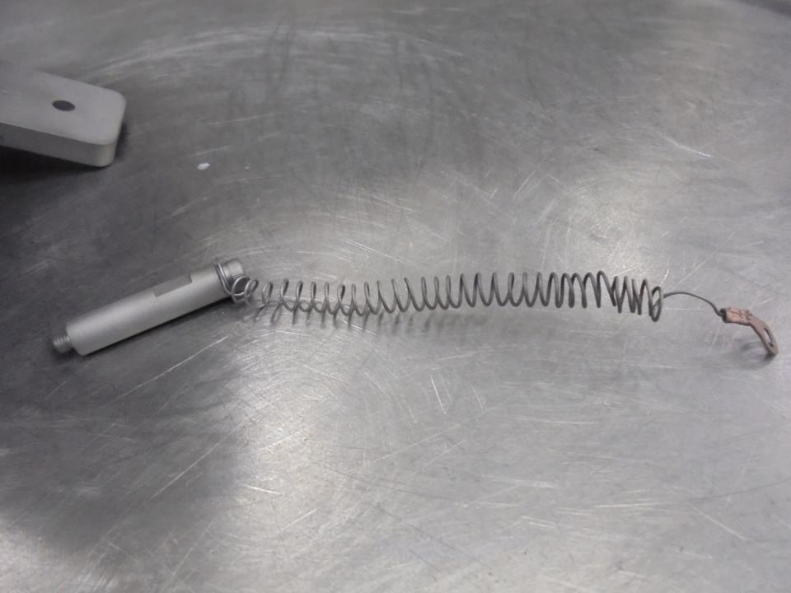
Stand-Off
HV ELECTRODE WIRE

Slide 21
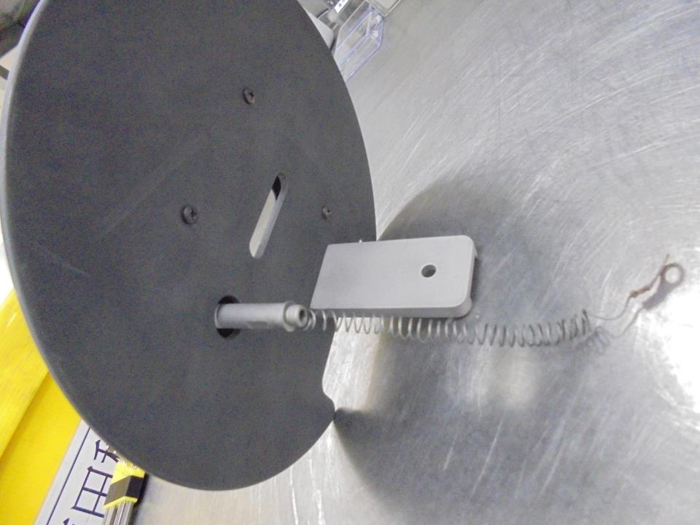
Install Here!

Slide 22
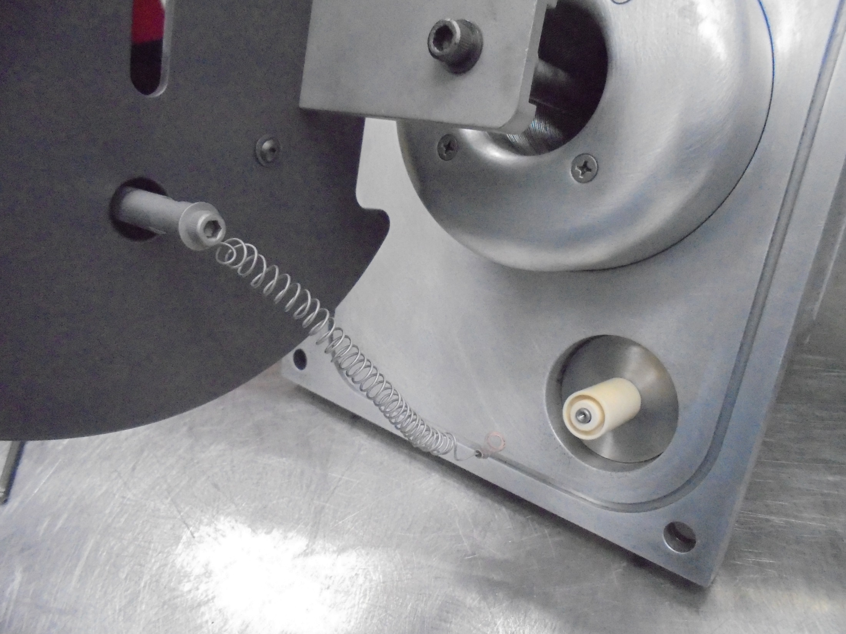

Install…
HV FEEDTHRU INSULATOR

Slide 23
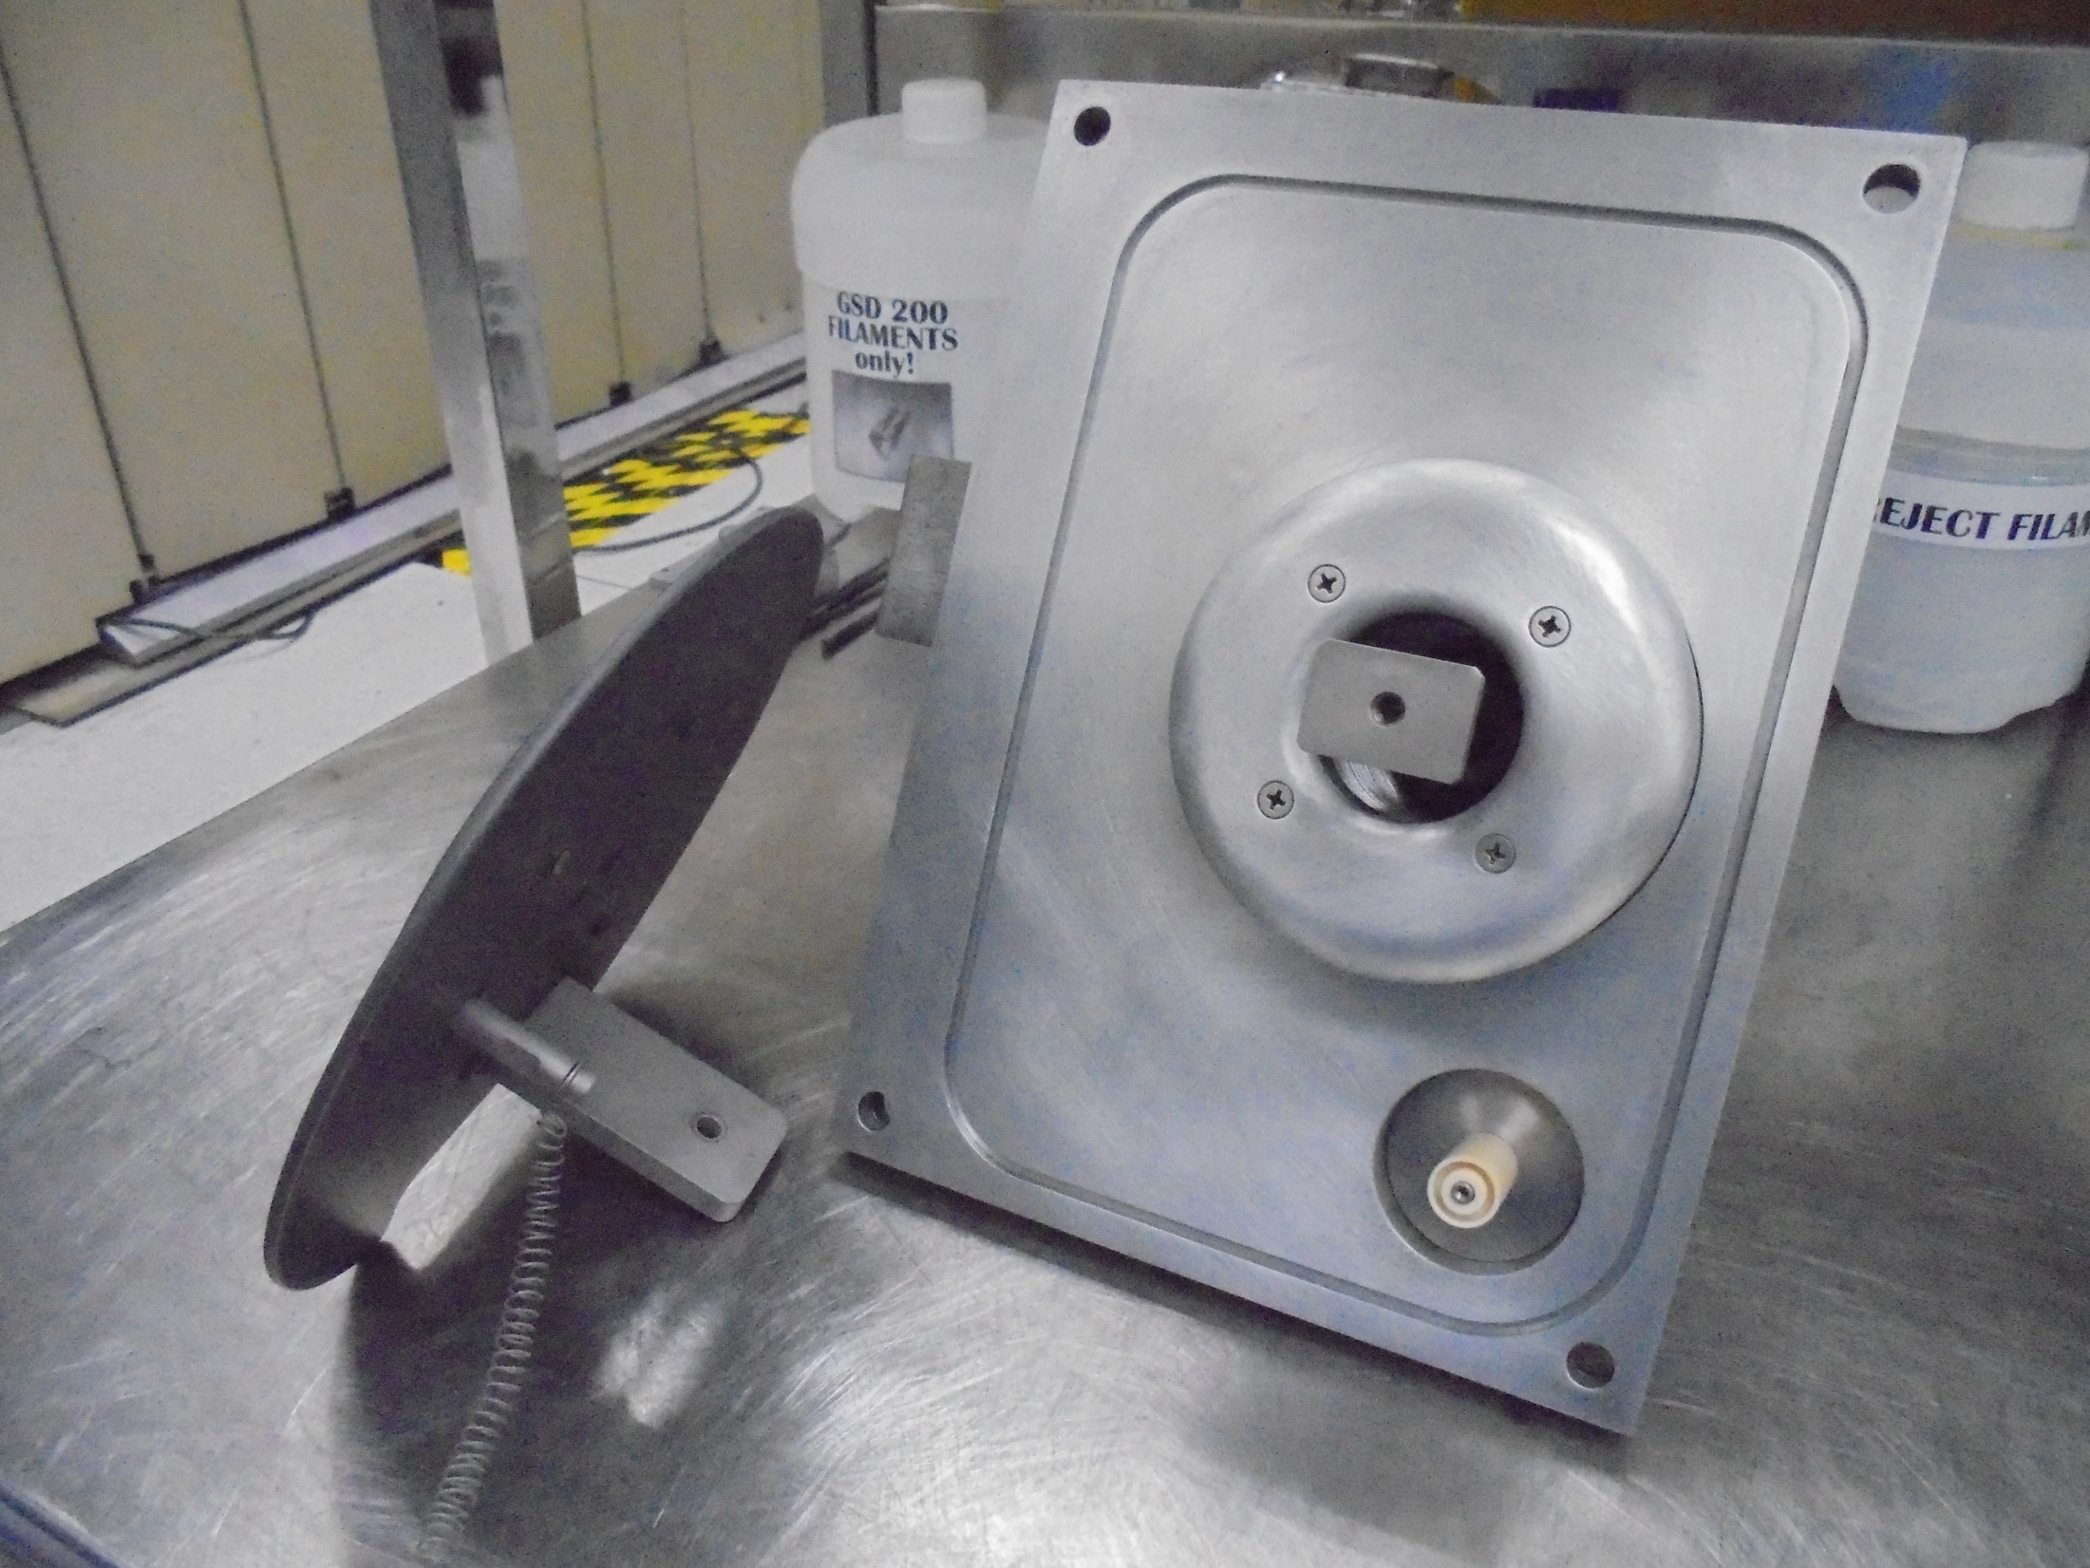
Re-Install EXTRACTION Part
To MANIPULATOR ASSY.

Slide 24
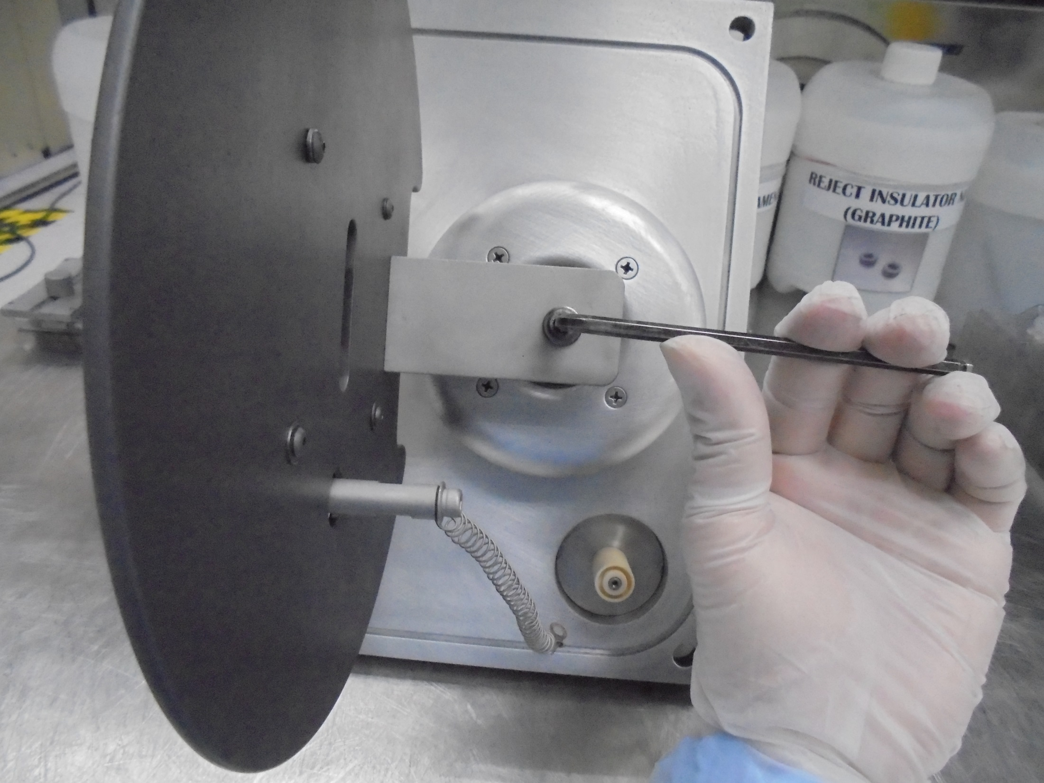
Secure Tighten The Screw

Slide 25
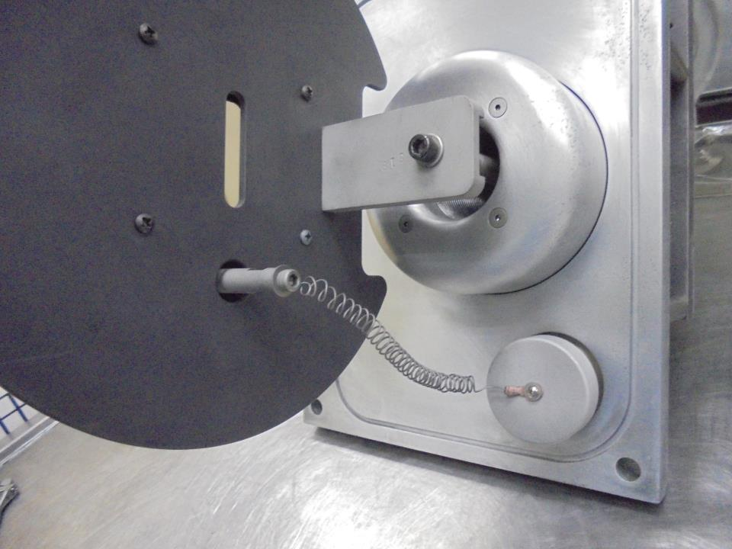

Connect The HV ELECTRODE Wire To The MANIPULATOR ASSY.
Here!
Install…
HV FEEDTHRU SHIELD

Slide 26
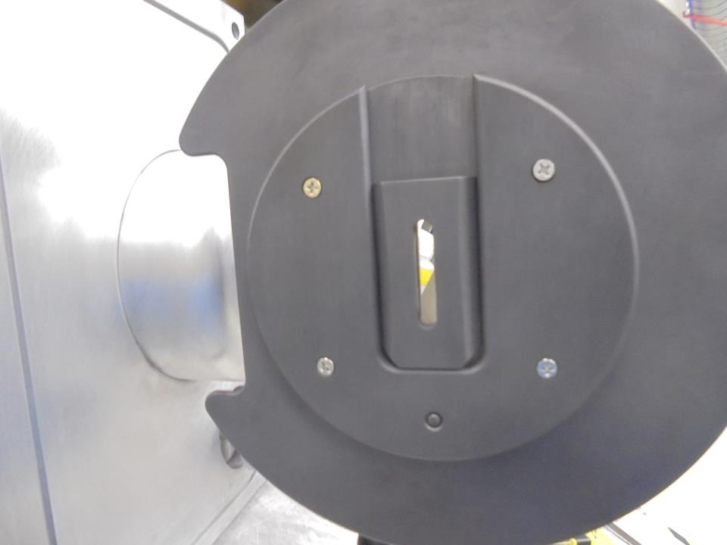
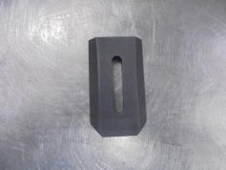
SUPPRESSION
ELECTRODE
INSERT
Here!

Slide 27
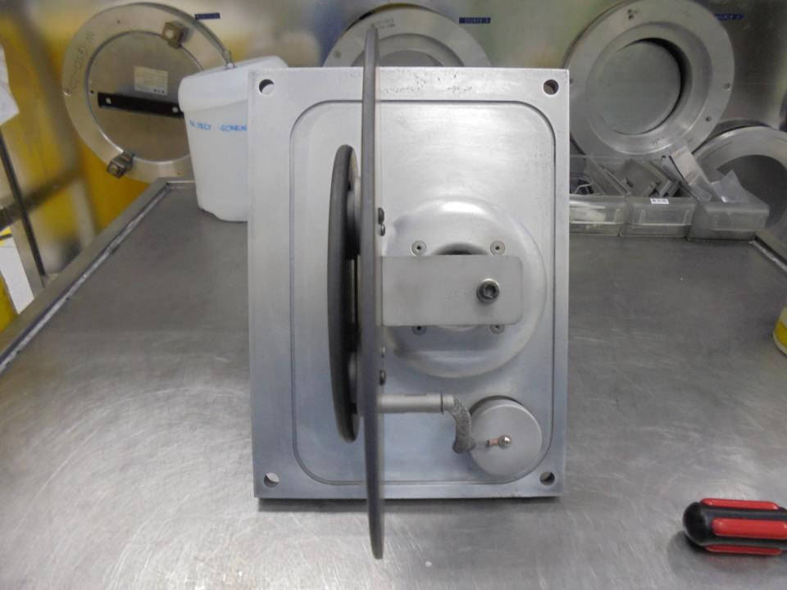
Clean O-RING Slot

Slide 28
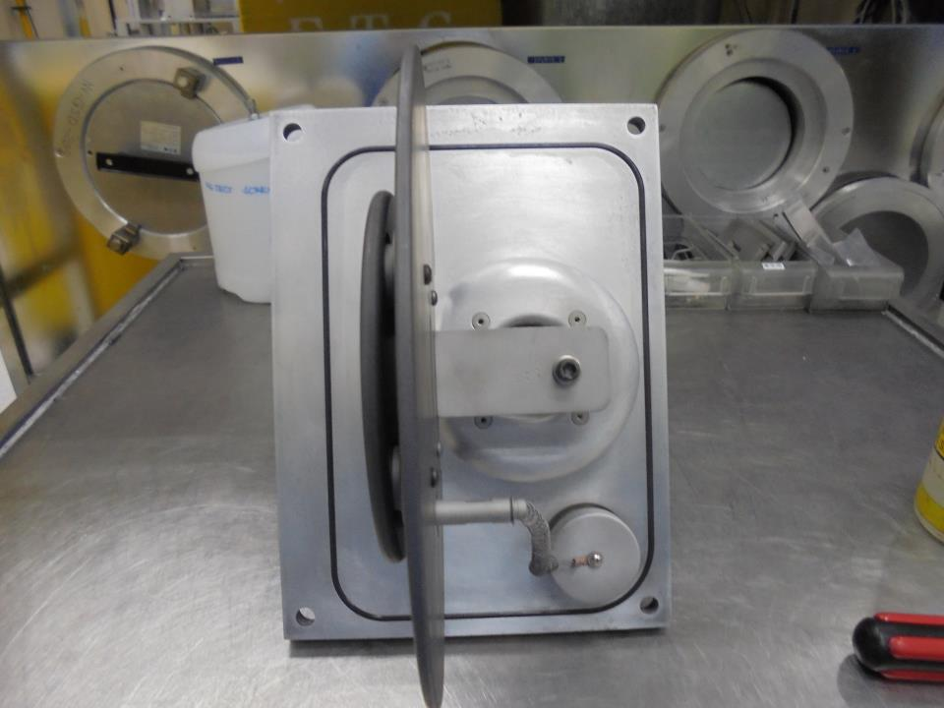
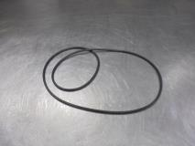
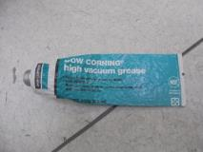
Clean O-RING
Check For Any Damages
Apply A Little Amount Of High Vacuum Grease

Slide 29
ISOLATION TEST

Slide 30
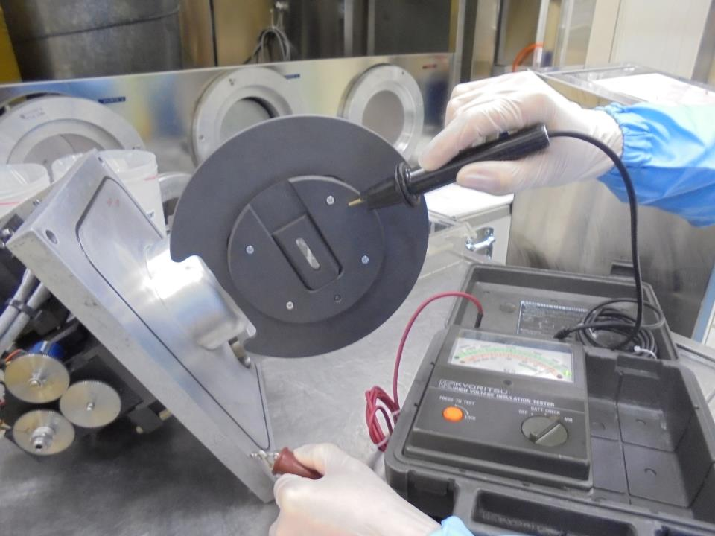
MANIPULATOR MOUNTING PLATE
BODY

Slide 31
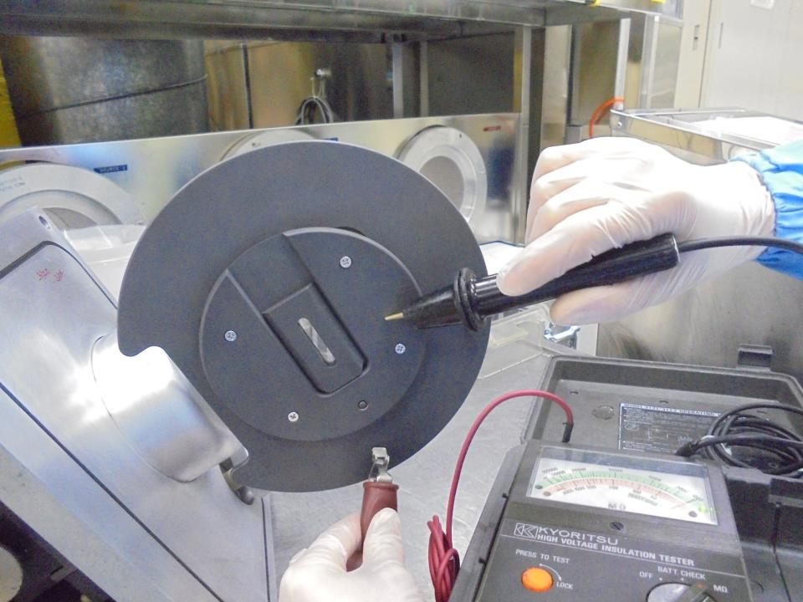
MANIPULATOR MOUNTING PLATE
GROUND ELECTRODE

Slide 32
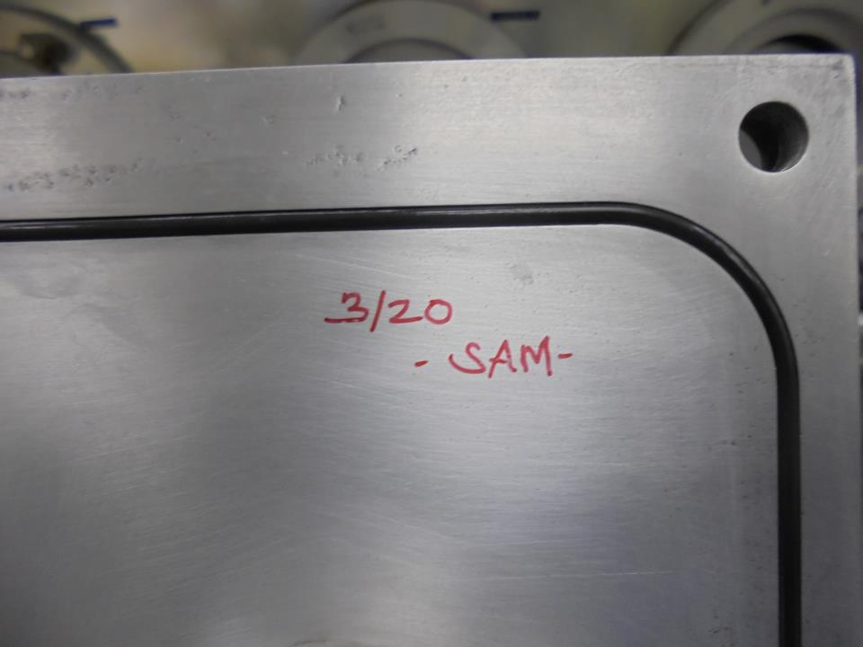
Sign NAME and DATE
Maintenance Done.

Slide 33
-END-

